Slide 1
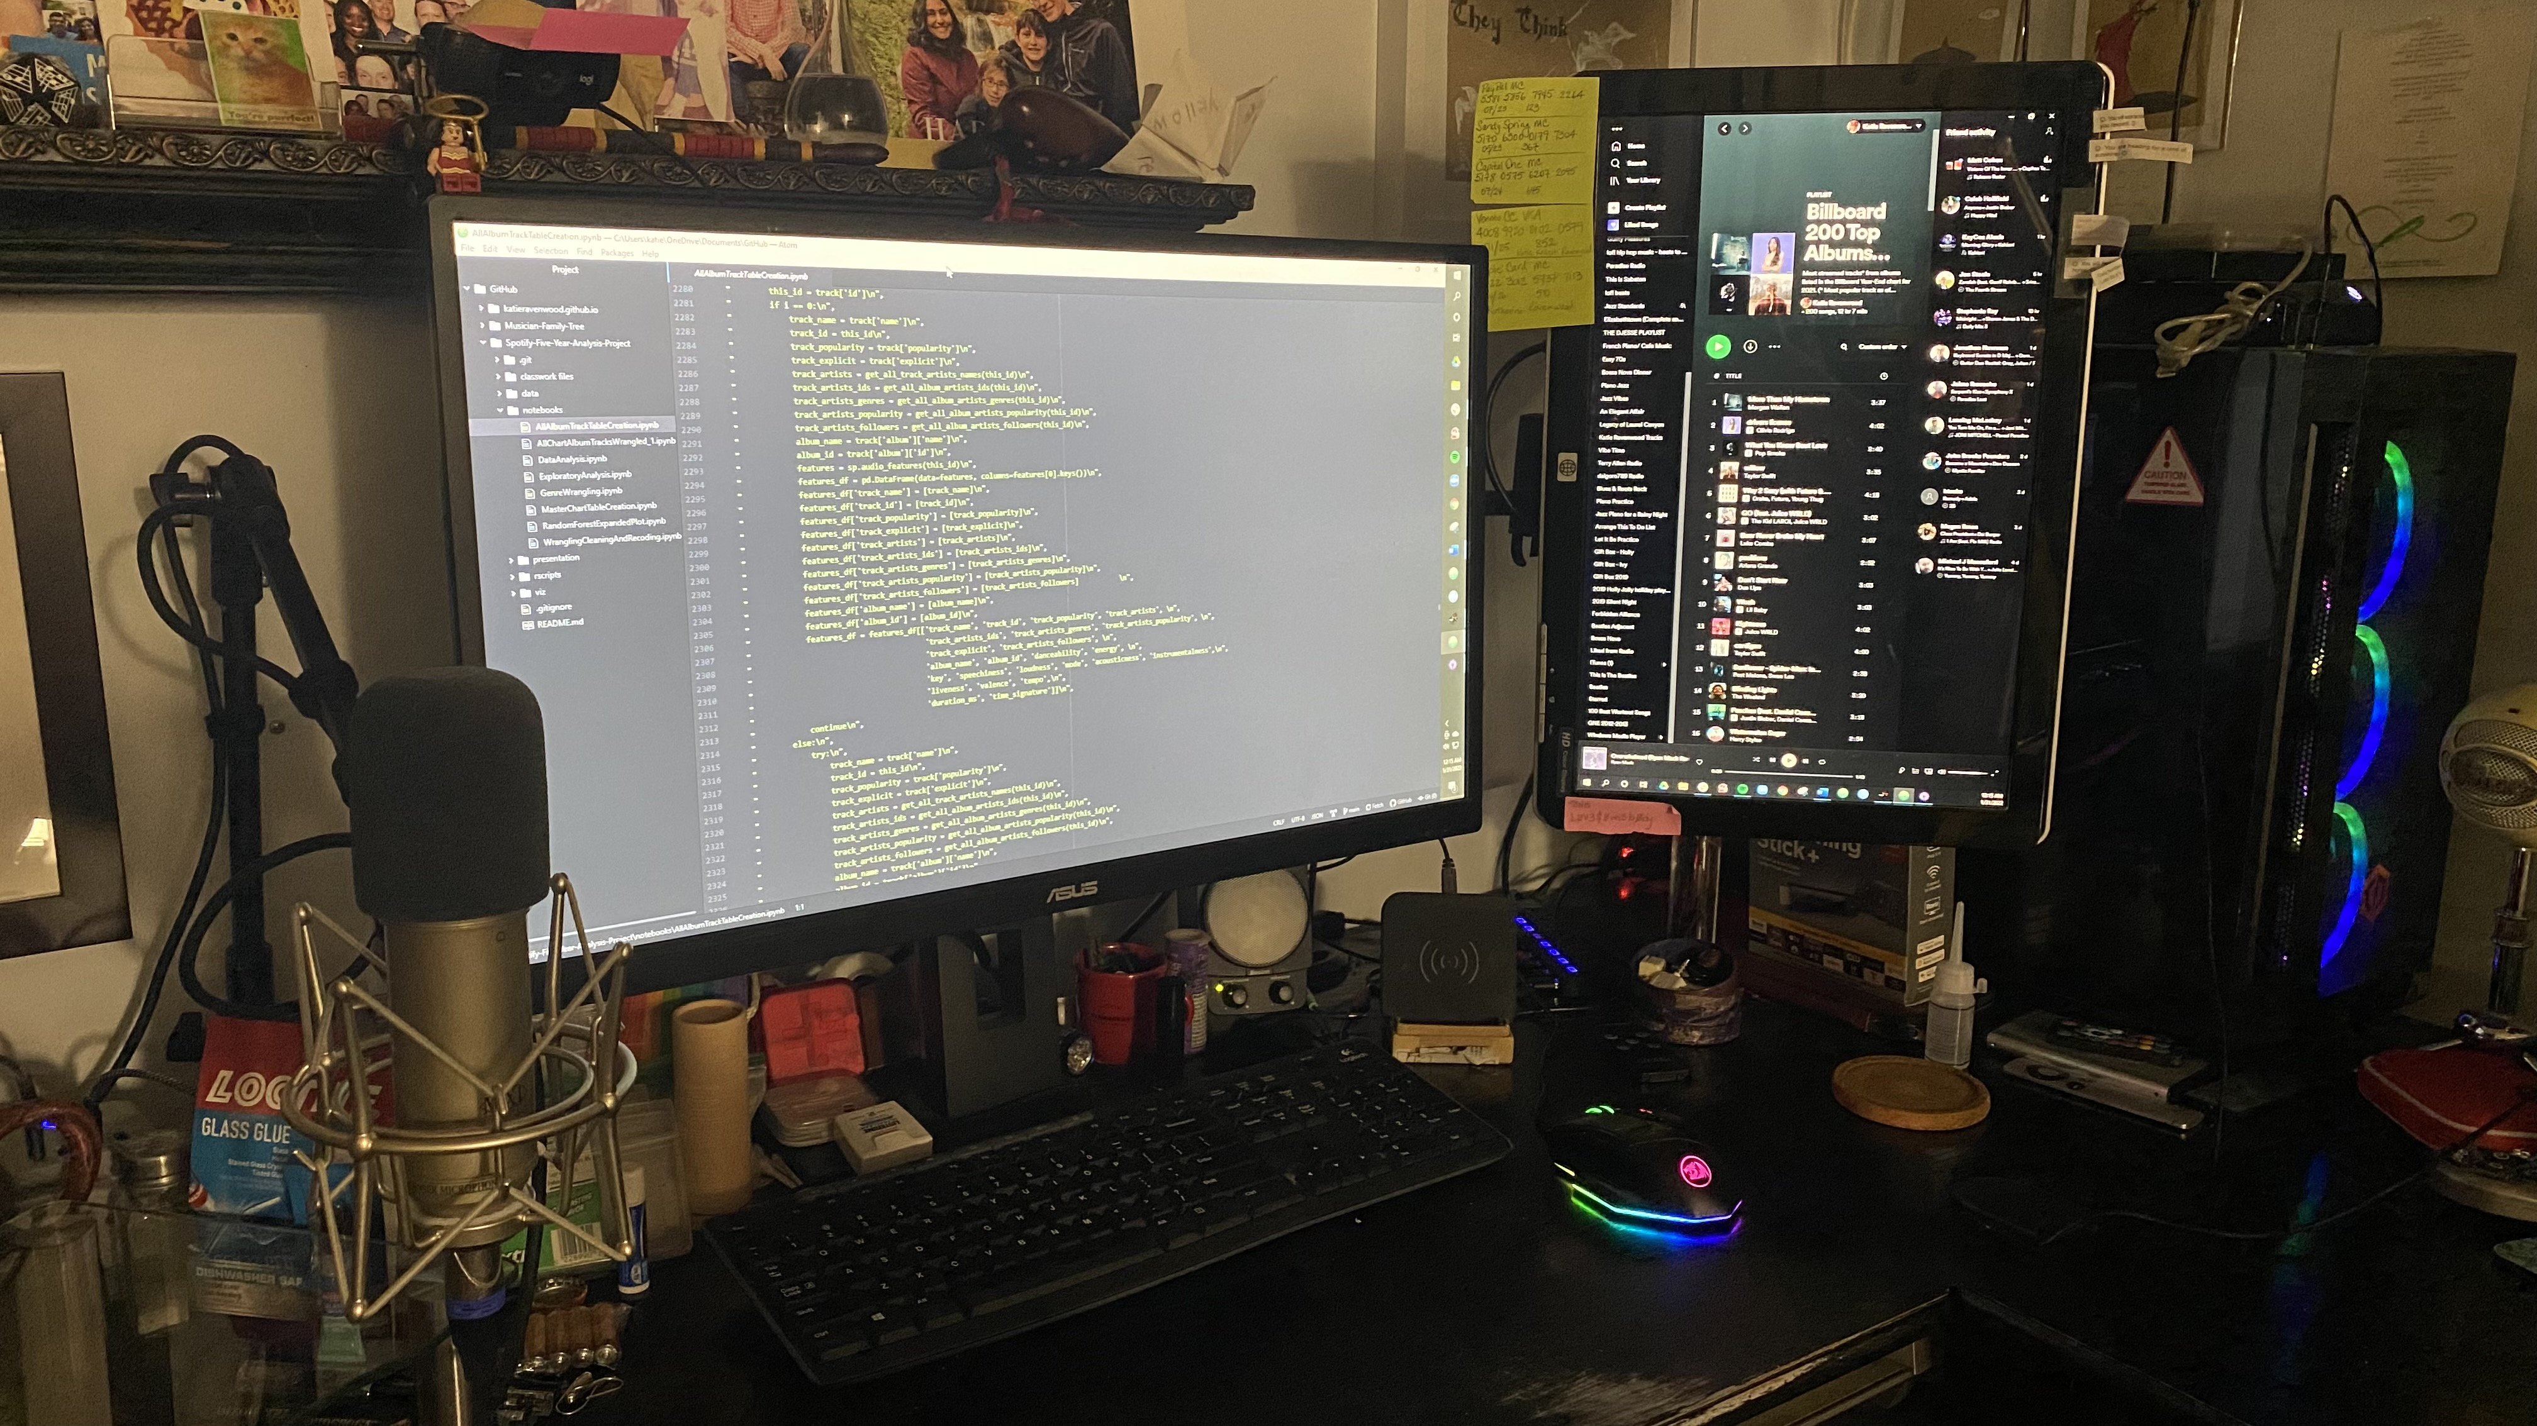
2017
2018
2019
2020
2021
https://bit.ly/SxB5YA
Title
Spotify x Billboard Top 200 Albums 5-Year Analysis Project
Bianca Serrano and Katie Ravenwood

Slide 2

PRESENTERS

Slide 3
PRESENTERS
BIANCA SERRANO
Educational background in psychology
Currently employed as a data coordinator
5 years experience in database management
Skills in:
Case management in government and educational systems
Reporting and data synthesis for presentation in Excel and government database systems
Interested in music through a background in event music curation and active listening

Slide 4
PRESENTERS
KATIE RAVENWOOD
Educational background in music & biochemistry
Currently employed as a musician & music teacher
25 years experience in music performance and music education
20 years of web development & marketing experience
Skills in:
Business administration and marketing
Contracting and contract negotiation
Front end design and development
Educational and curriculum design
Interest in music through a background in performance and concert promotion

Slide 5

BACKGROUND

Slide 6


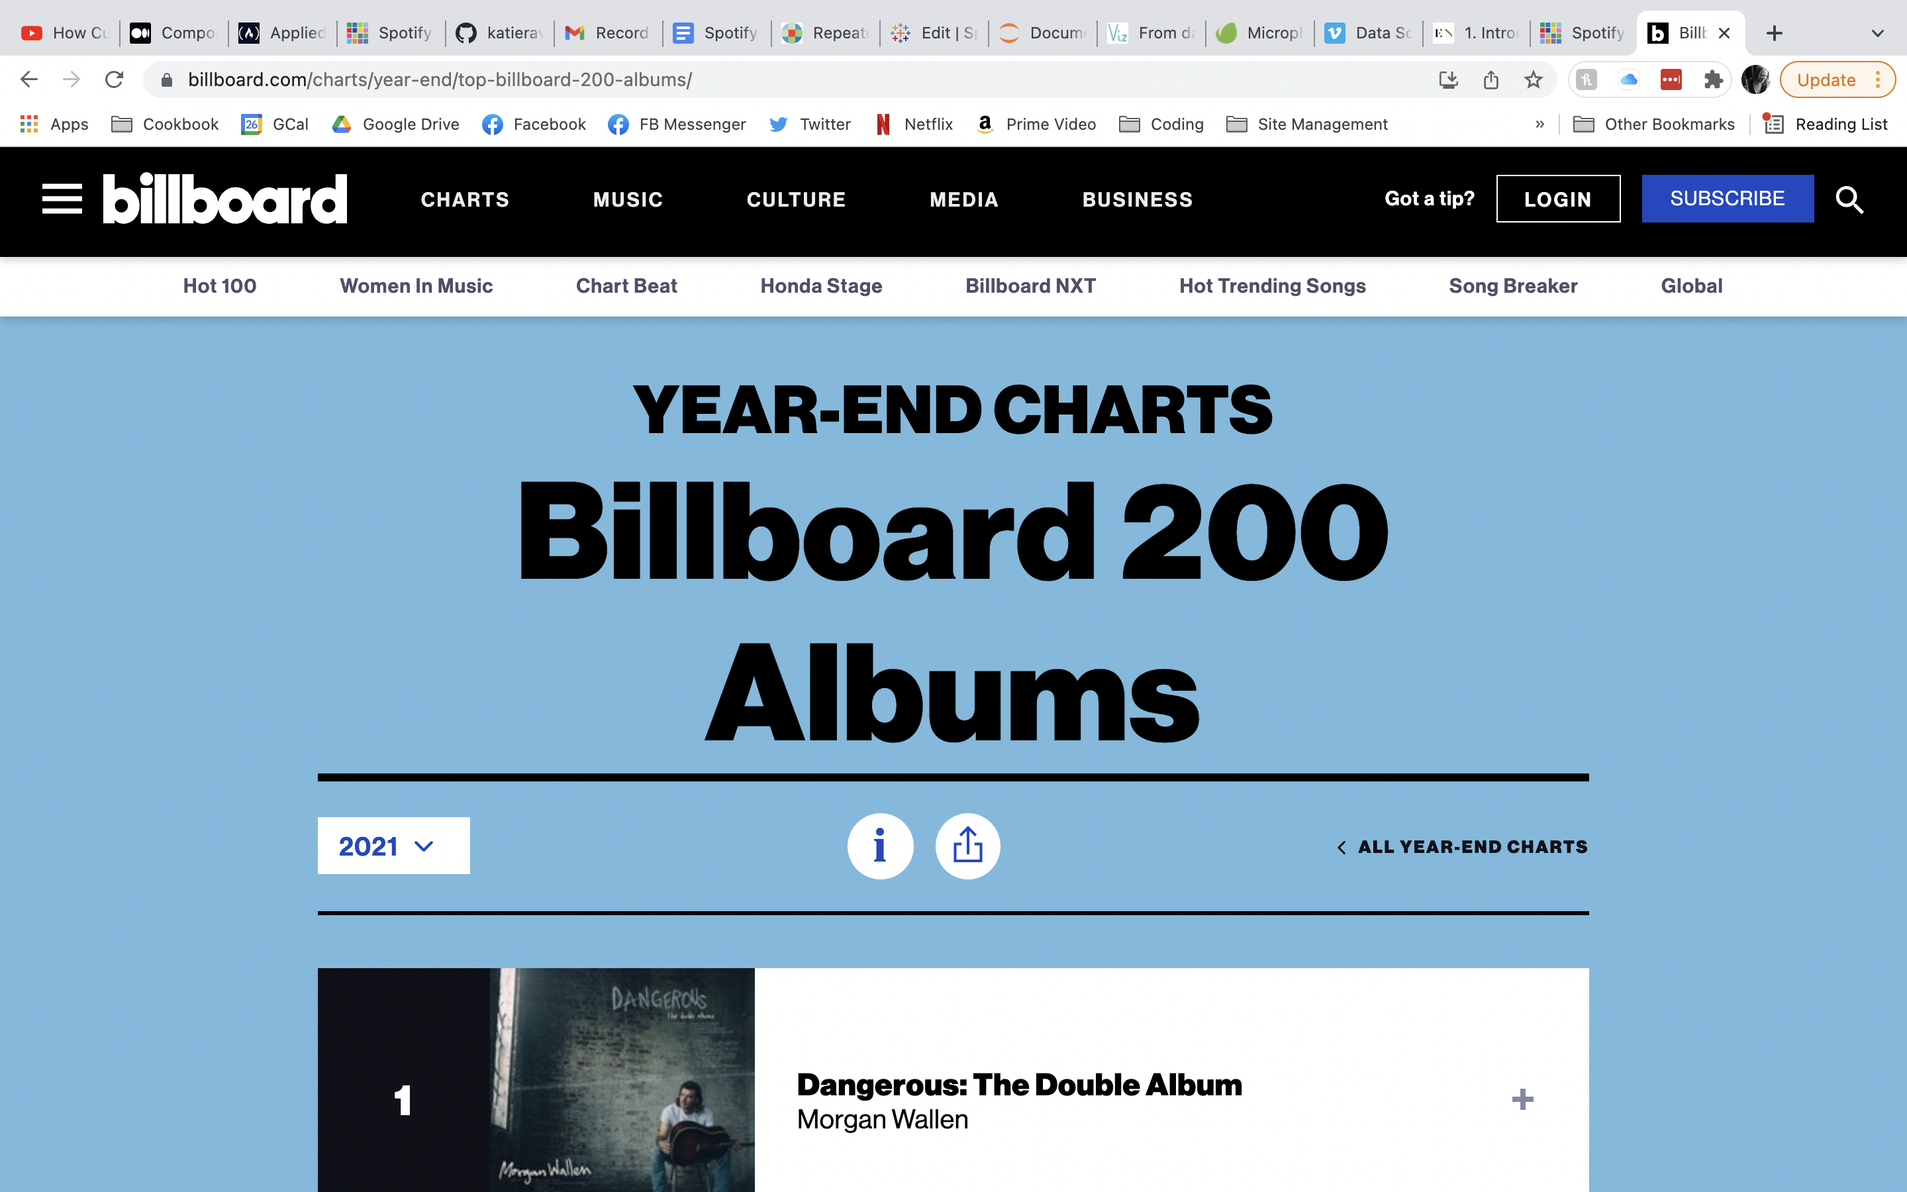
Billboard is an American music and entertainment magazine founded in 1894 and now operating in several countries around the world.
Billboard is best known for its weekly charts, including the Billboard 200 albums ranking and the Hot 100 singles chart, as well as its yearly 200 Albums chart.
The Top 200 Album chart lists the year's most popular albums across all genres, ranked by physical and digital album and track sales as well as audio on-demand streaming activity.
Billboard charts are powered byinformation from MRC Data (formerly Nielsen Music or Nielsen Soundscan.)
Source: “Billboard”. Music Business Worldwide, 31 January 2022. https://www.musicbusinessworldwide.com/companies/billboard/

Slide 7


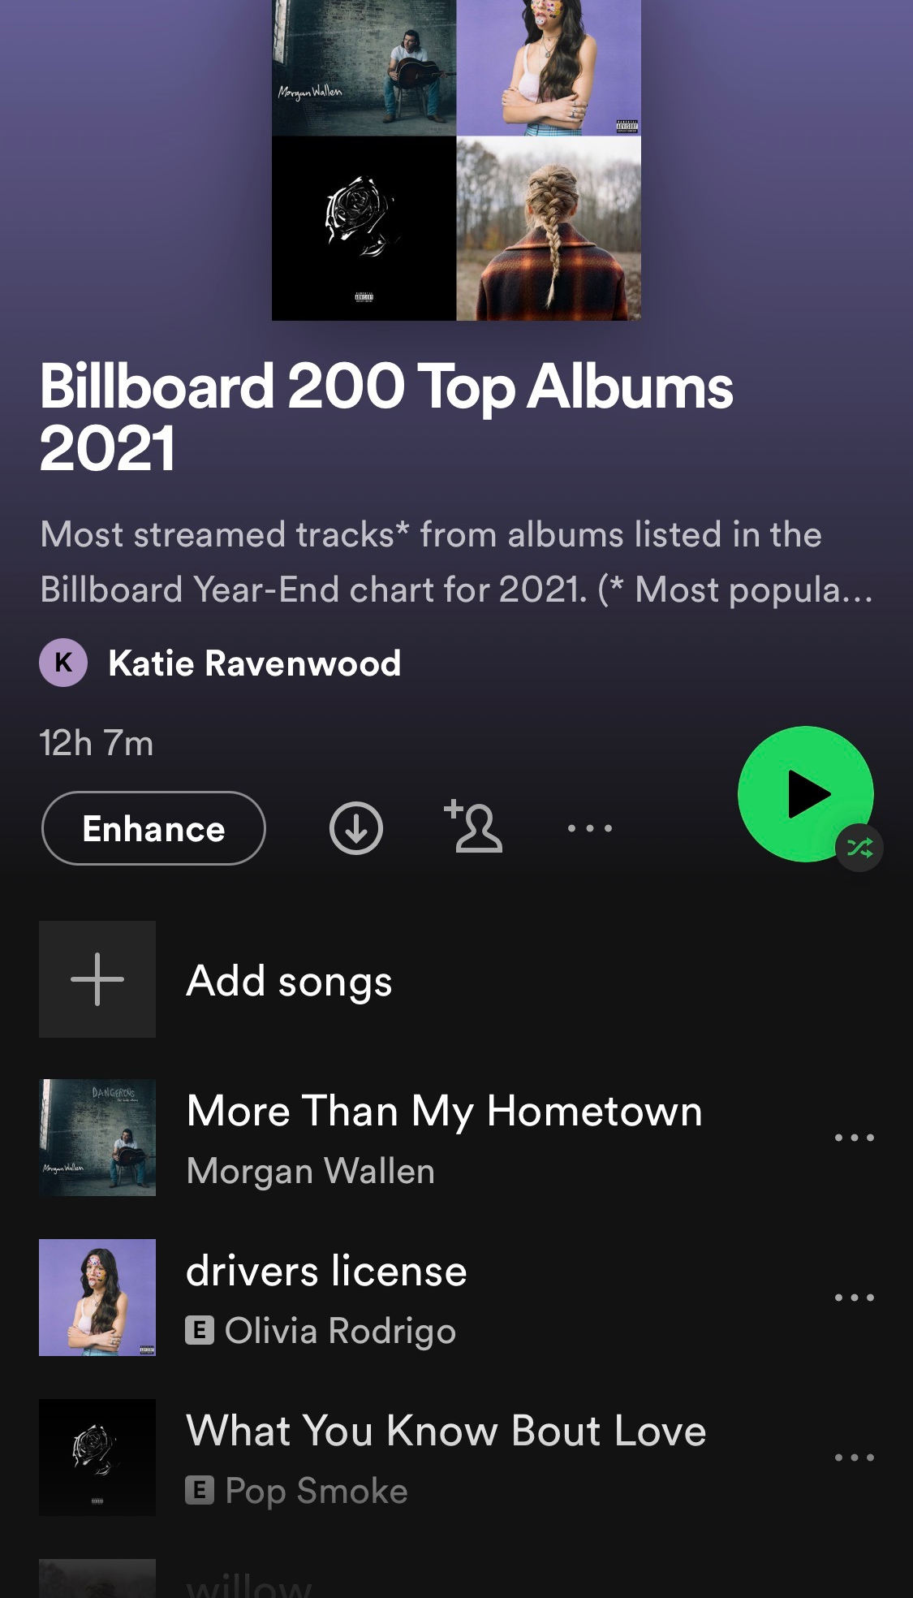
HISTORY
Spotify was founded in 2006 in Stockholm, Sweden, by Daniel Ek and Martin Lorentzon.
USERS
365 million people use Spotify at least once a month, and 165 million are paid subscribers.
CATALOG
More than 70 million songs are available on Spotify.
API
Data is available to developers through Spotify’s API, and includes information about artists, albums, and tracks.
Source: “Spotify Revenue & Usage Statistics.” Business of Apps, 19 January 2022, https://www.businessofapps.com/data/spotify-statistics/

Slide 8

METHODS

Slide 9

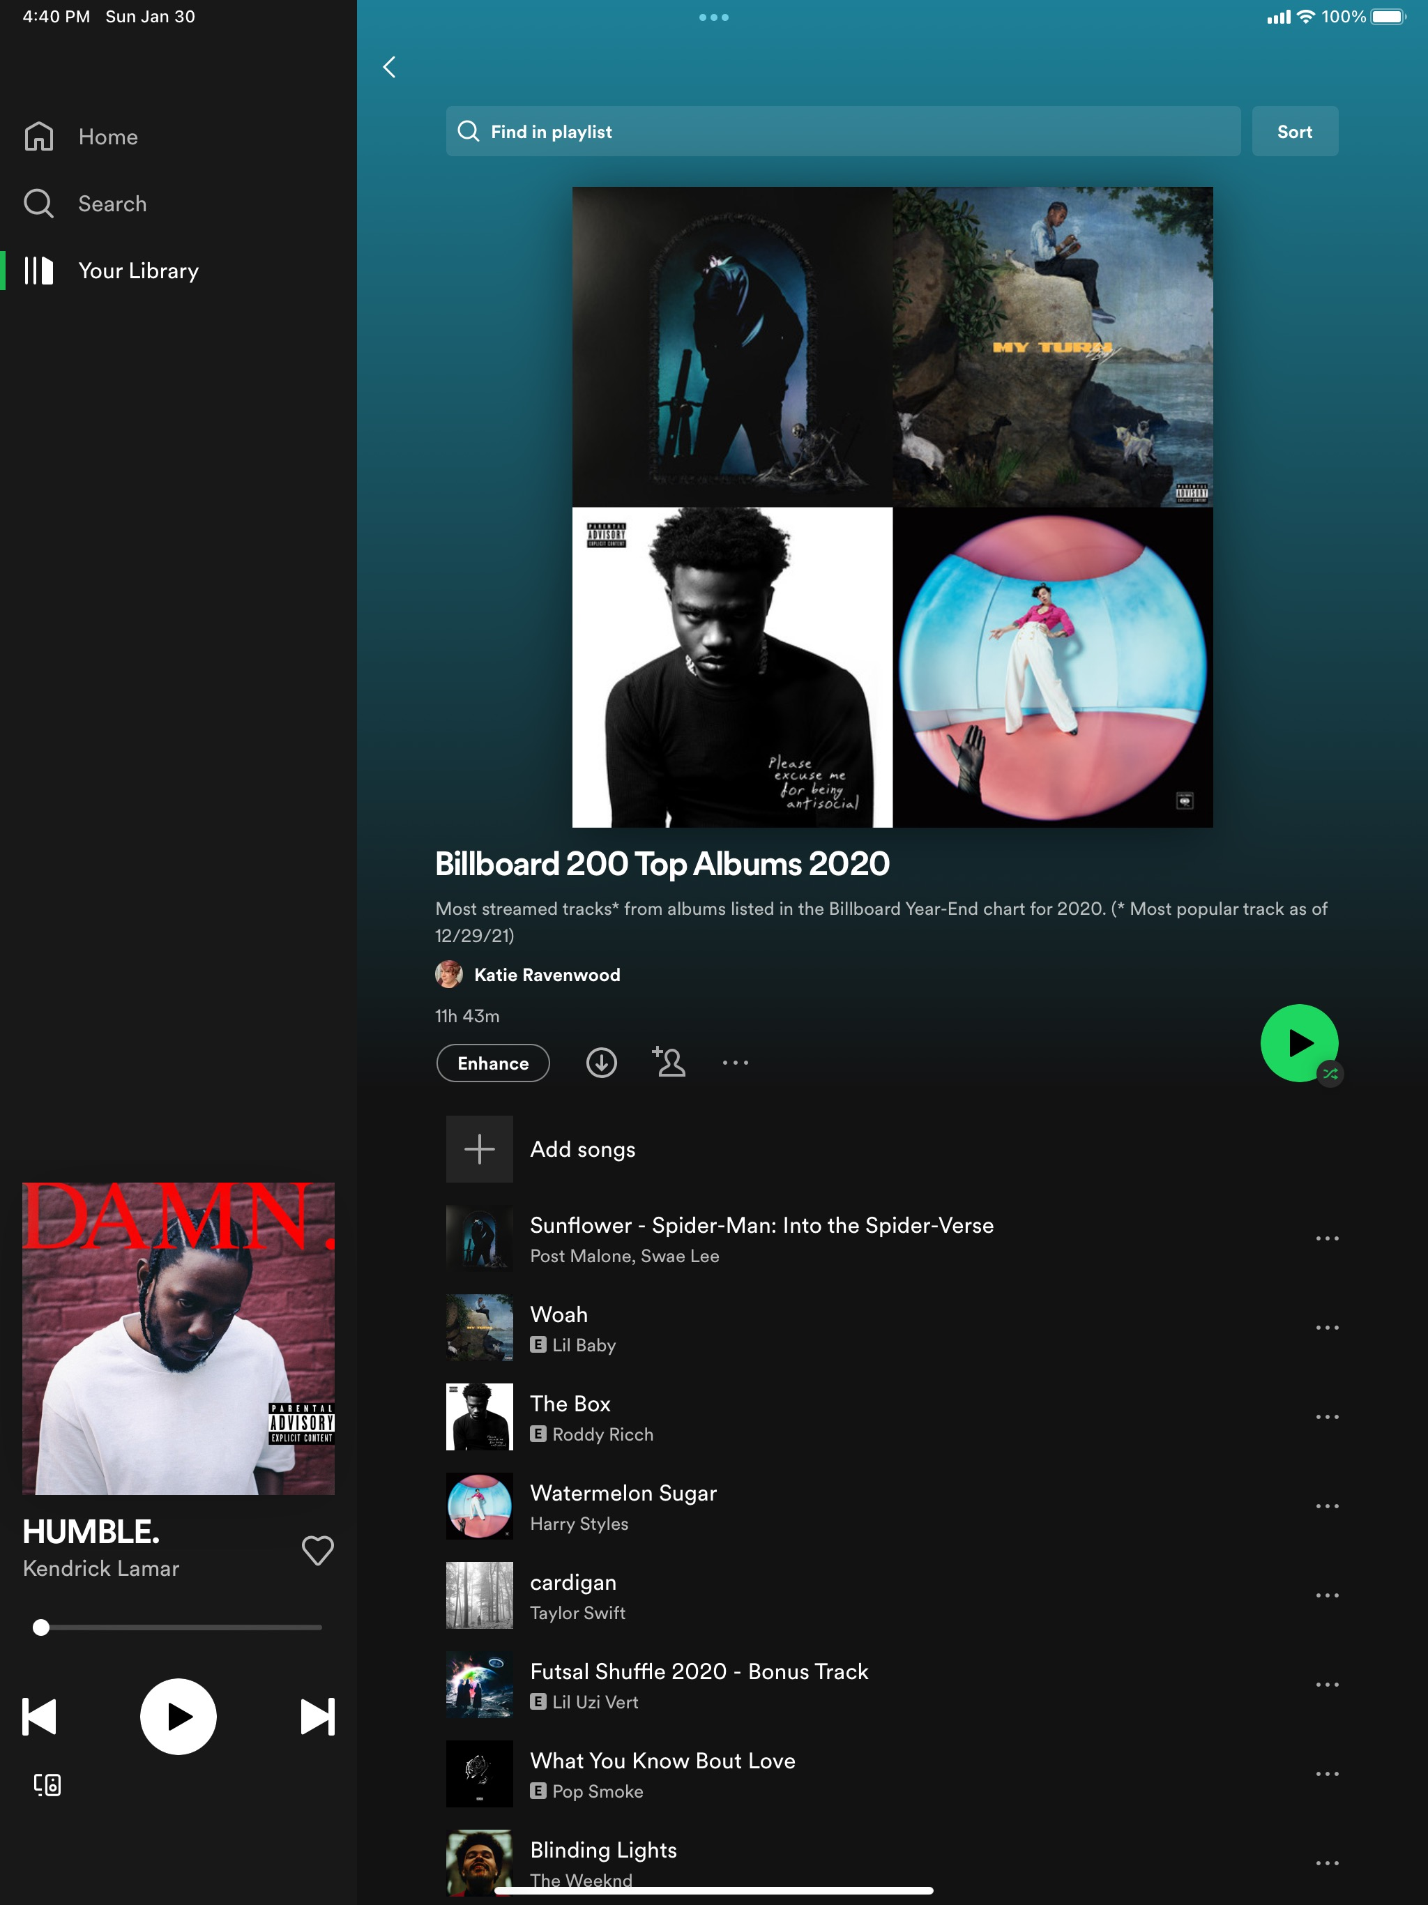
DATASET CREATION
PYTHON & SPOTIPY
Data tables of album and track information were created with Python using the SpotiPy package.
Playlists of each
chart were
created in Spotify
to provide endpoints
for accessing chart data.
Included variables:
Billboard Album Chart Name & Year
Album ID, Name, Release Year
Album artists' names, IDs, popularity, and associated genres
Track artists' names, IDs, popularity, and associated genres
Explicit labeling designation
Audio features
SPOTIFY PLAYLISTS
01.
Billboard 200 Top Albums 2017
02.
Billboard 200 Top Albums 2018
03.
Billboard 200 Top Albums 2019
04.
Billboard 200 Top Albums 2020
05.
Billboard 200 Top Albums 2021

Slide 10





DATA WRANGLING
JOINS
FEATURES
TRACK & ALBUM
TABLES
CLEANING &
DUMMY CODING
Multiple joins for various charts and analyses
Removing null values and dummy coding genres for analysis
GENRES
DATES
UN-NESTING LISTS
RECODING TO DATETIME
Wrangling nested lists of genres linked by artist
Recoding release dates and chart years to datetime format

Slide 11

RESULTS

Slide 12
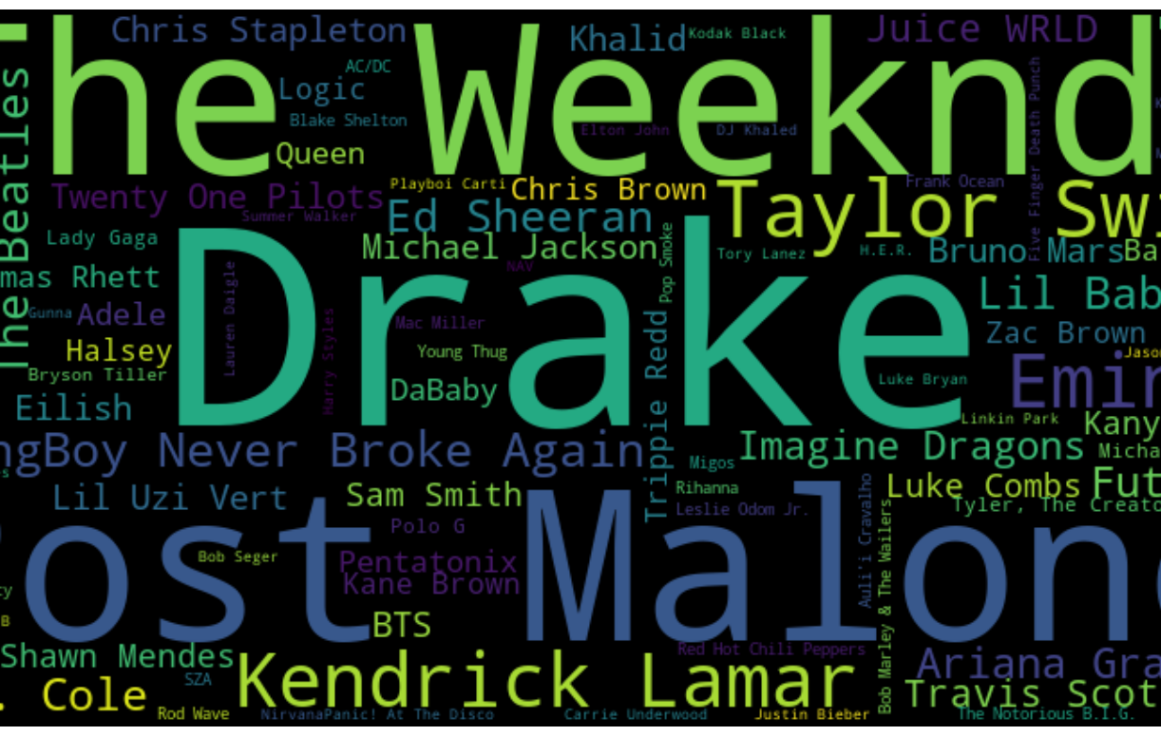
Interesting Data Points
Shape of the tracks dataframe: 16,501 rows and 57 variables
Most popular song: ”good for you” by Olivia Rodrigo and “Woman” by Doja Cat
Average song length: 3 minutes and 22 seconds
Longest song: “Like I Never Left” by Future at 25 minutes 33 seconds
Most frequently appearing album artist: Drake (31 times)
Appearances by Taylor Swift (15), Queen (7), and Elton John (4)
Oldest track: “The Christmas Song (Merry Christmas To You)” released in 1962
Newest track: “Bad Morning” by Young Boy Never Broke Again released on October 5, 2021.

Slide 13
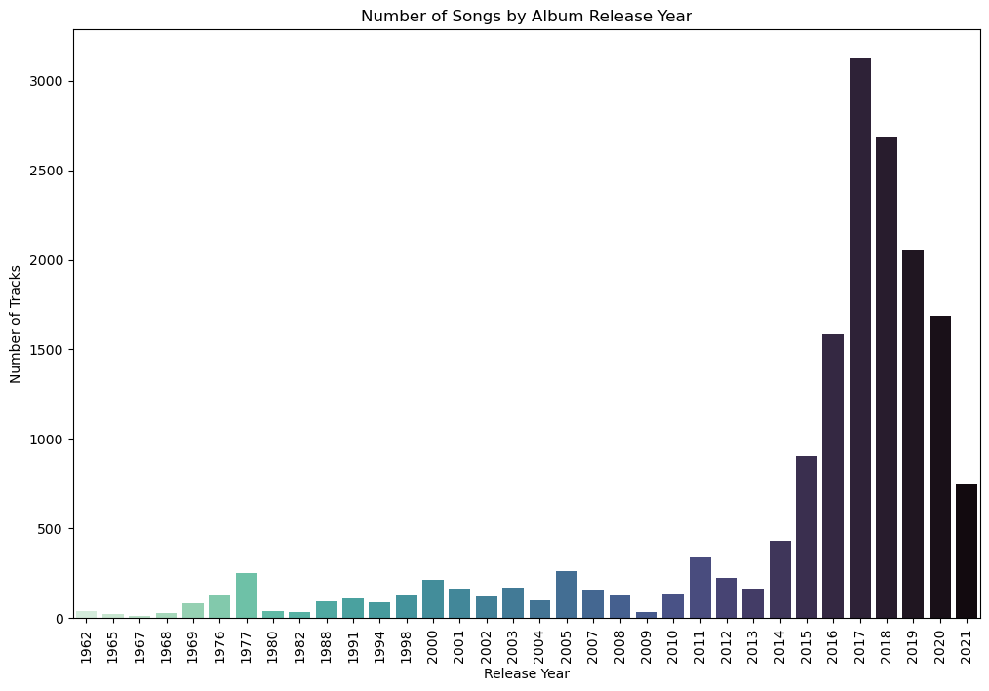
NUMBER OF TRACKS BY RELEASE YEAR

Slide 14
AUDIO FEATURES
SPEECHINESS (0 -> 1)
Detects the presence of spoken words in a track.
ACOUSTICNESS (0 -> 1)
KEY (-1 to 11)
TEMPO (BPM)
A confidence measure of how likely it is that the track is performed acoustically (as opposed to amplified.
The key the track is in. Integers map to pitches using standard Pitch Class notation.
Beats-per-minute measure of the speed or pace of a track derived from beat duration.
DANCEABILITY. (0 -> 1)
LIVENESS (0 -> 1)
TIME SIGNATURE (3 to 7)
How suitable a track is for dancing based on elements including tempo and beat strength and overall regularity.
Detects the presence of an audience in the recording. Greater than 0.8 is likely recorded live.
Specifies how many beats in each measure or bar of music.
ENERGY (0 -> 1)
LOUDNESS (-60 to 0)
VALENCE (0 -> 1)
Measures intensity and activity in a track, influenced by dynamics, loudness, timbre, onset rate, and general entropy.
Average loudness of a track’s normalization level in decibels across the entre track.
Measures the musical positiveness of a track. Higher values equal more cheerfulness.
INSTRUMENTALNESS (0 -> 1)
MODE (1 or 0)
EXPLICIT (T/F)
Confidence measure that predicts whether a track contains no vocals (oohs and aahs are considered non-vocal sounds.)
Indicates whether a track is major (1) or minor (0).
Indicates whether the track has been marked for Parental Advisory labelling. False indicates not marked or no information given.

Slide 15
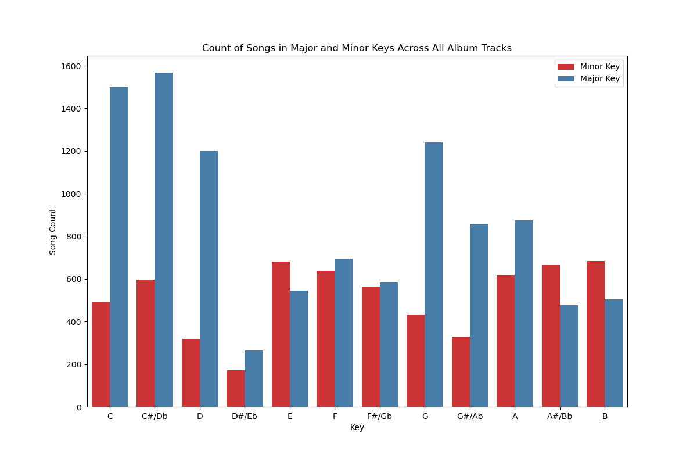
TRACK COUNT BY MAJOR & MINOR KEY

Slide 16
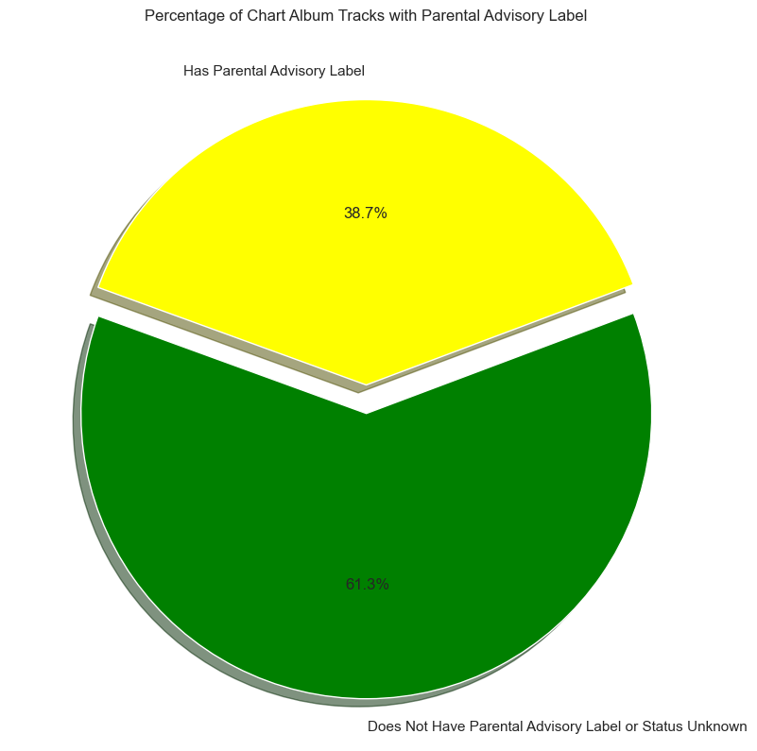
PARENTAL ADVISORY LABELING
Result of Parents Music
Resource Center (PMRC)
Congressional Hearings in 1985
Labels are voluntarily applied
by record labels or artists
Album-wide labeling
Missing data
Labels are subjectively applied
No set standard for labeling

Slide 17
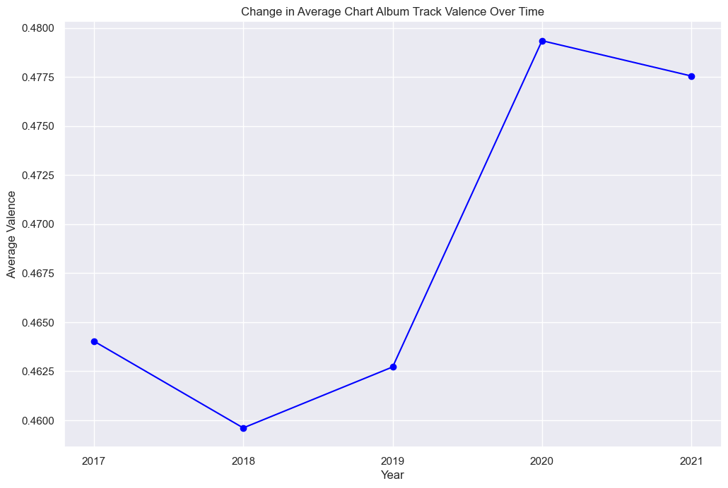
CHANGE IN VALENCE OVER TIME

Slide 18
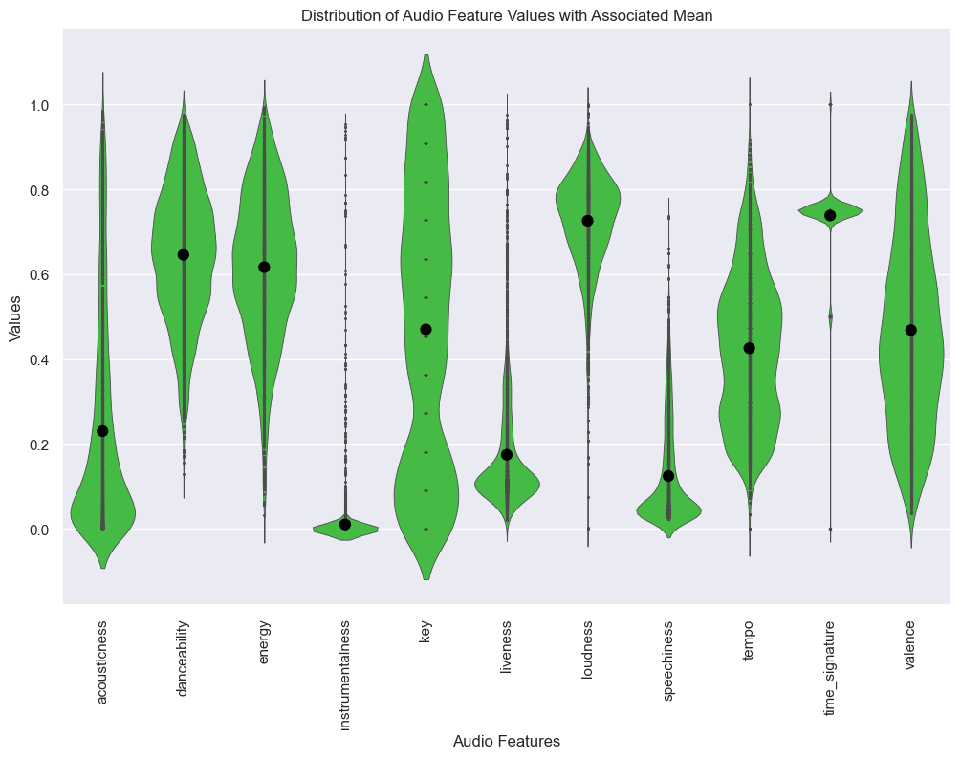
DISTRIBUTION OF AUDIO FEATURE VALUES

Slide 19
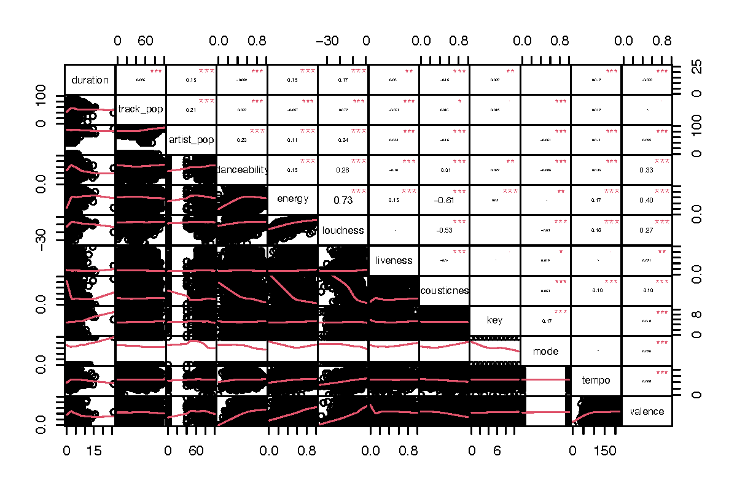
CORRELATION MATRIX OF FEATURES

Slide 20
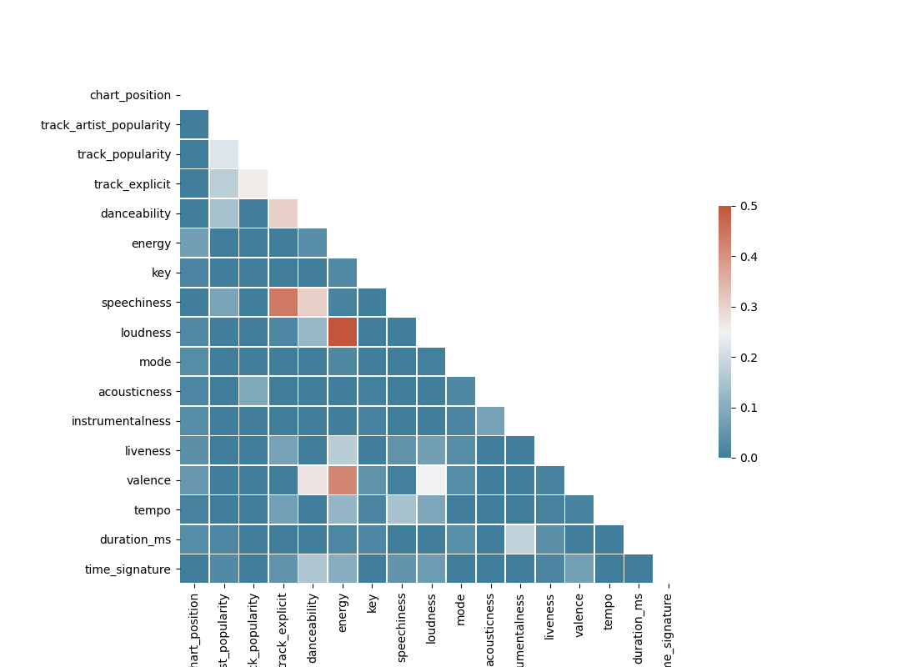
CORRELATION HEAT MAP OF FEATURES

Slide 21
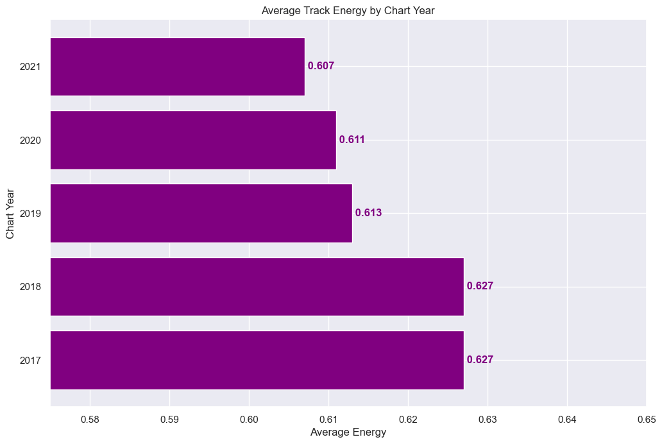
ENERGY

Slide 22
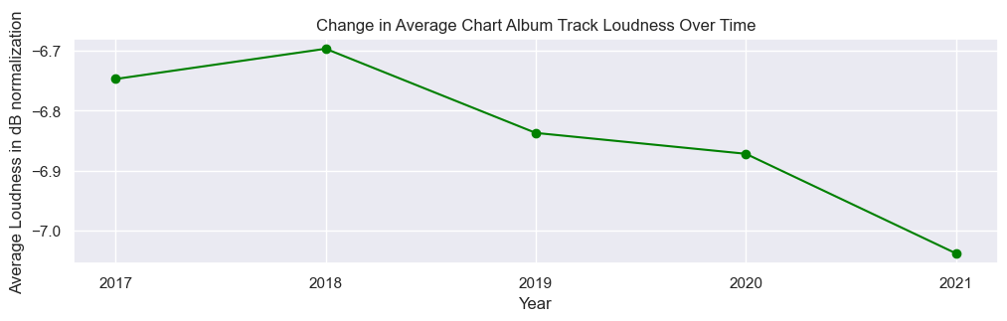
CHANGE IN LOUDNESS OVER TIME
-6.75 dB
-6.70 dB
-6.84 dB
-6.87 dB
-7.04 dB
2017
2018
2019
2020
2021

Slide 23
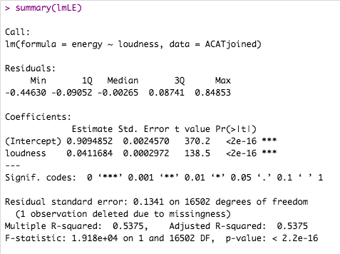
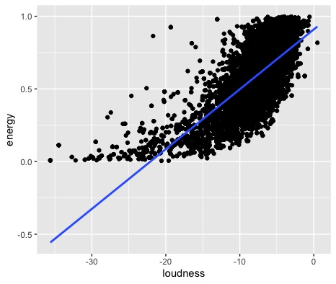
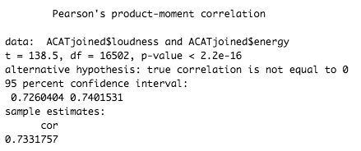
CORRELATION BETWEEN ENERGY & LOUDNESS

Slide 24
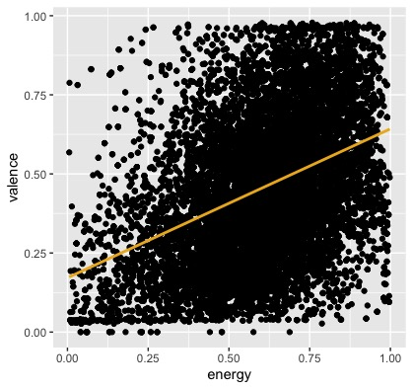
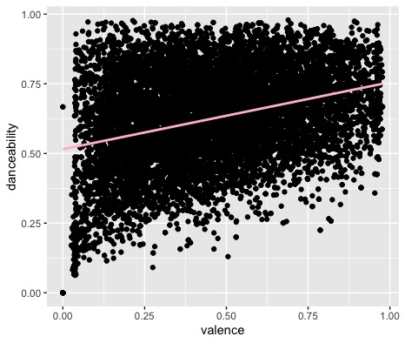
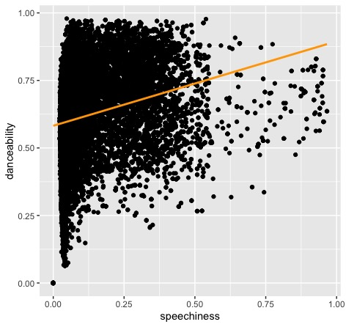
FURTHER CORRELATIONS
Valence &
Energy
Danceability & Valence
Danceability &
Speechiness

Slide 25
NO OR WEAK CORRELATION
(Replace Plot)
(Replace Plot)

Slide 26
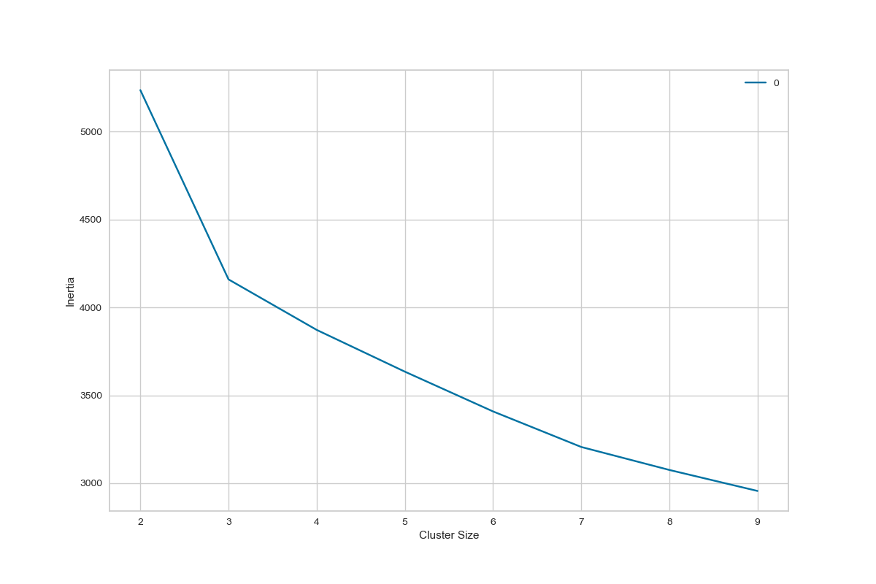
K-MEANS CLUSTERING
IDEAL NUMBER of CLUSTERS: 3

Slide 27
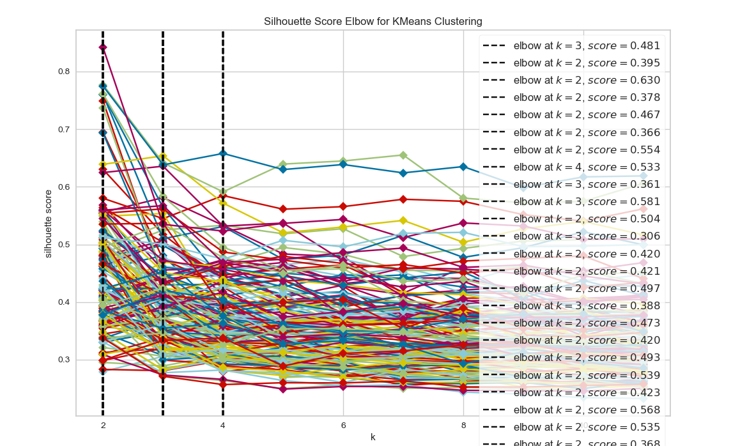
POSSIBLE FEATURE COMBINATIONS

Slide 28
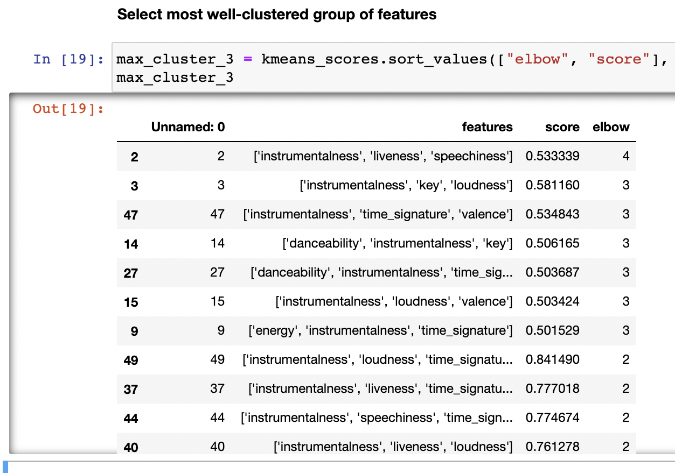
CLUSTERING SCORES
BEST CLUSTER GROUP OF 3:
INSTRUMENTALNESS
LIVENESS
SPEECHINESS
0.53339

Slide 29
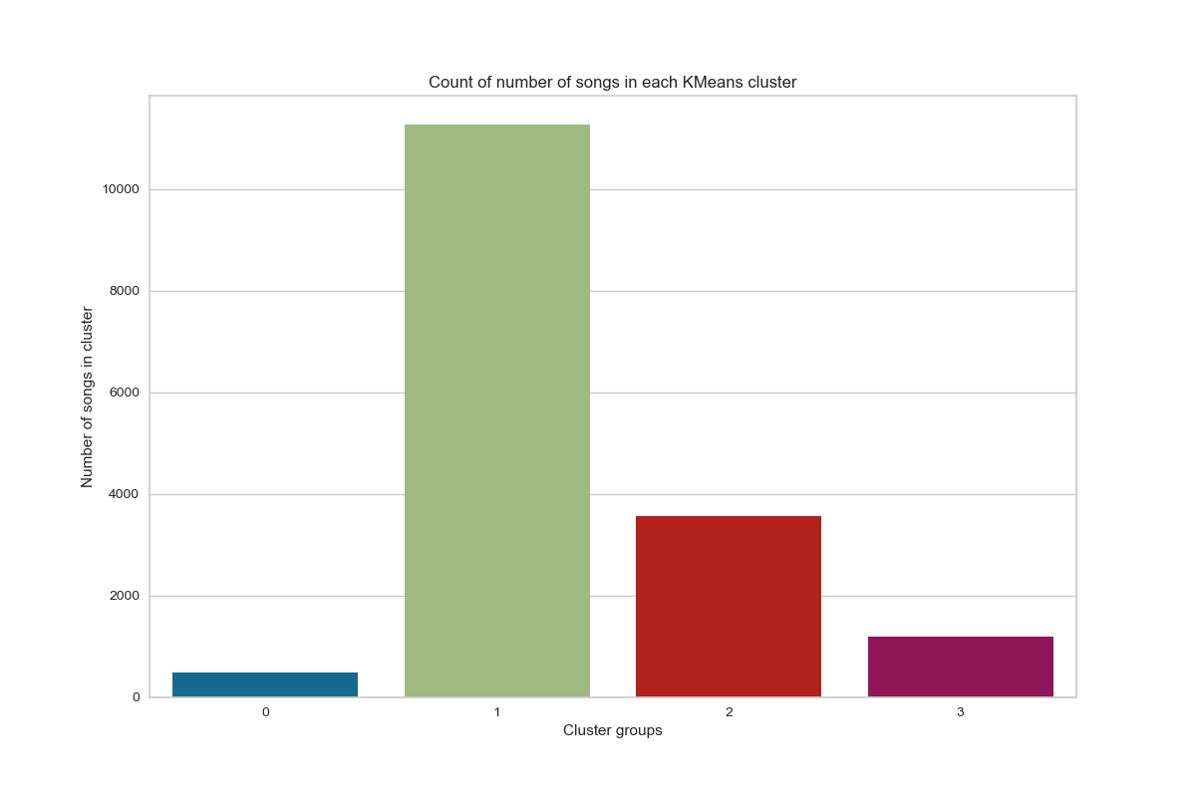
CLUSTERED TRACK GROUPS

Slide 30
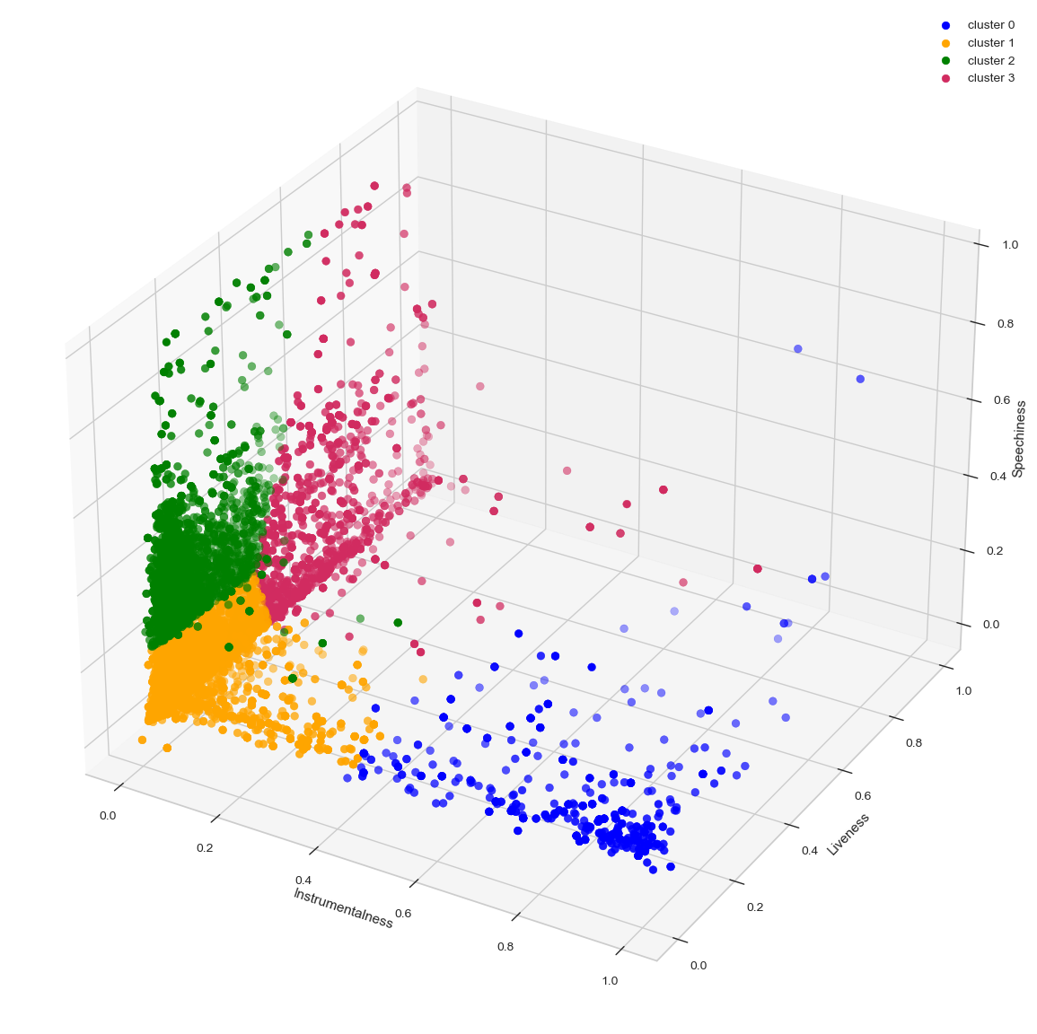
KMEANS CLUSTERS
1st Cluster:
Mid-high instrumentalness
Low-mid liveness
Low-mid speechiness
2nd Cluster:
Low-mid instrumentalness
Low-mid liveness
Low-mid speechiness
3rd Cluster:
Low instrumentalness
Low-mid liveness
Mid-high speechiness
4th Cluster:
Low instrumentalness
Mid-high liveness
Low-mid speechiness

Slide 31
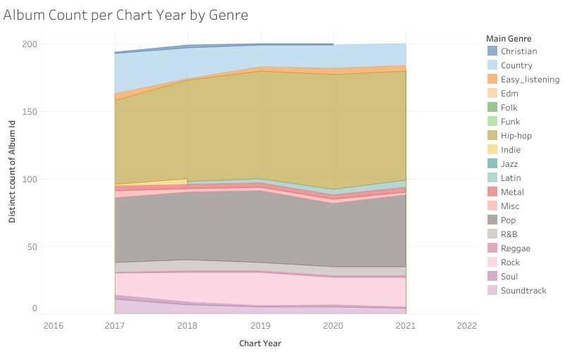
ALBUM COUNT PER CHART YEAR BY GENRE

Slide 32
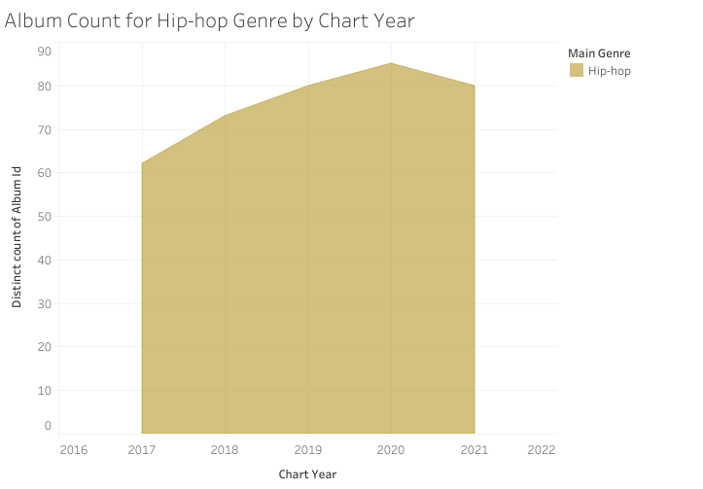
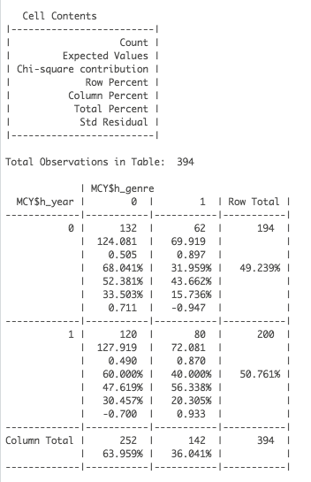
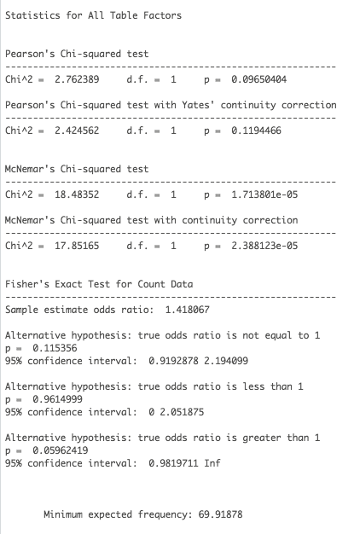
ALBUM COUNT PER CHART YEAR FOR HIP-HOP GENRE

Slide 33
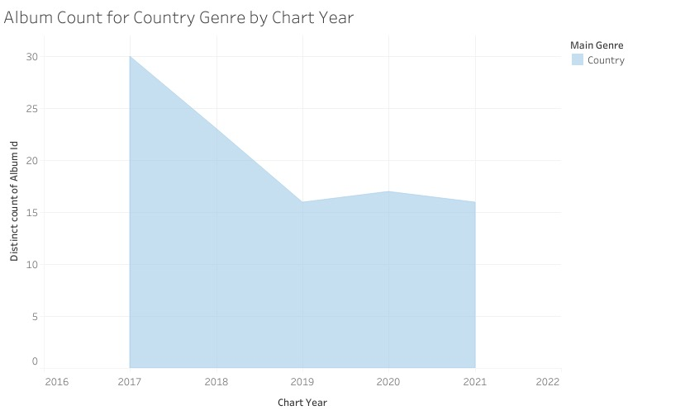
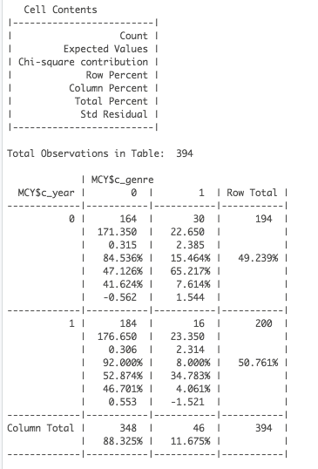
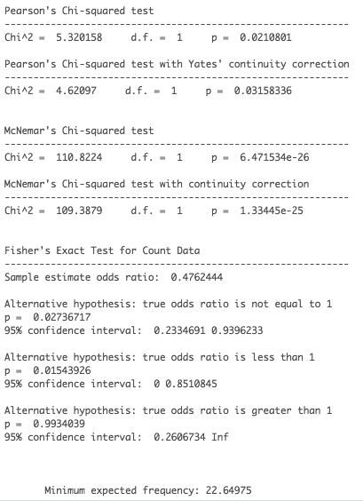
ALBUM COUNT PER CHART YEAR FOR COUNTRY GENRE

Slide 34
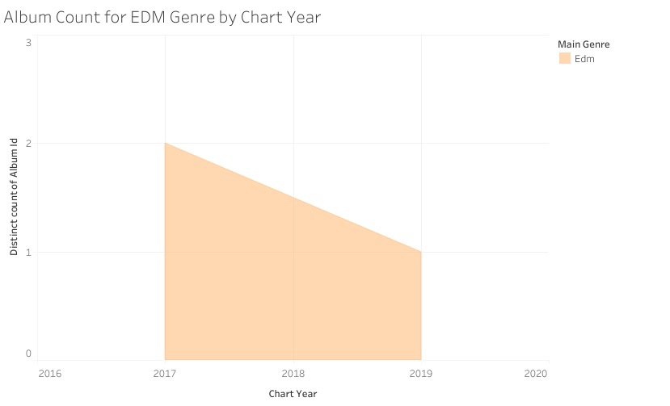
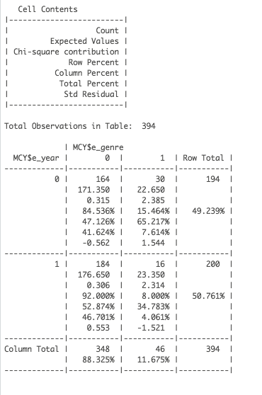
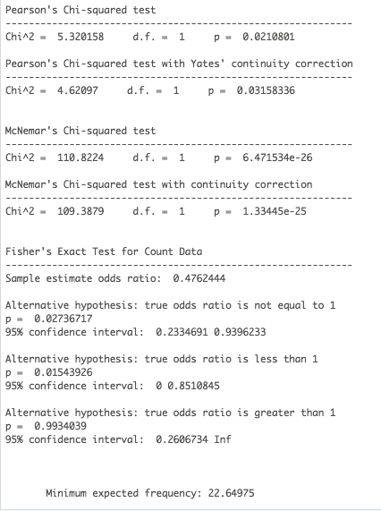
ALBUM COUNT PER CHART YEAR FOR EDM GENRE

Slide 35
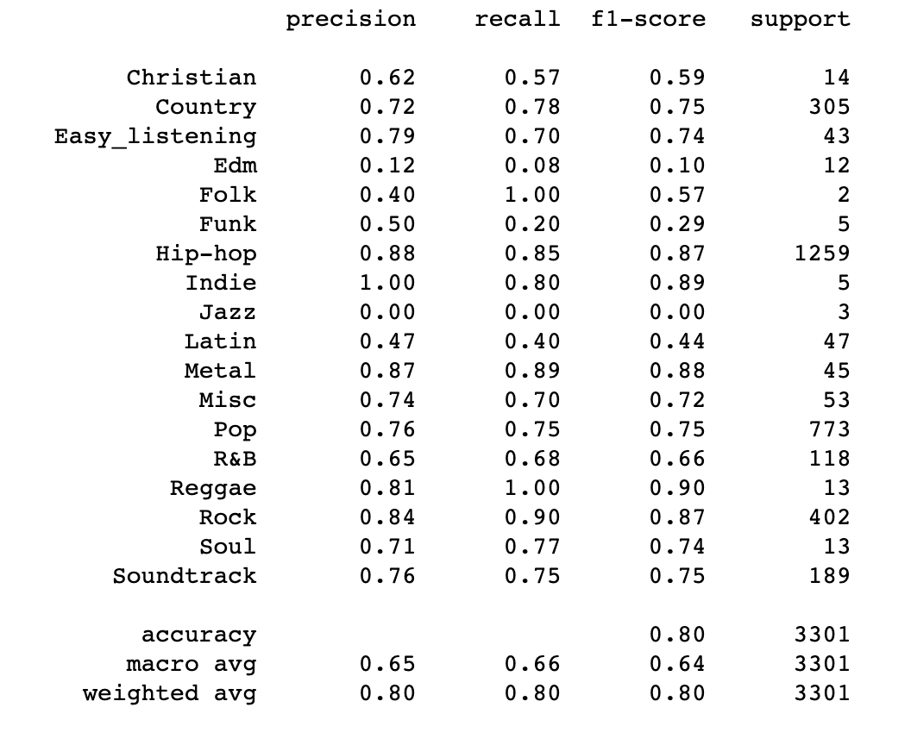
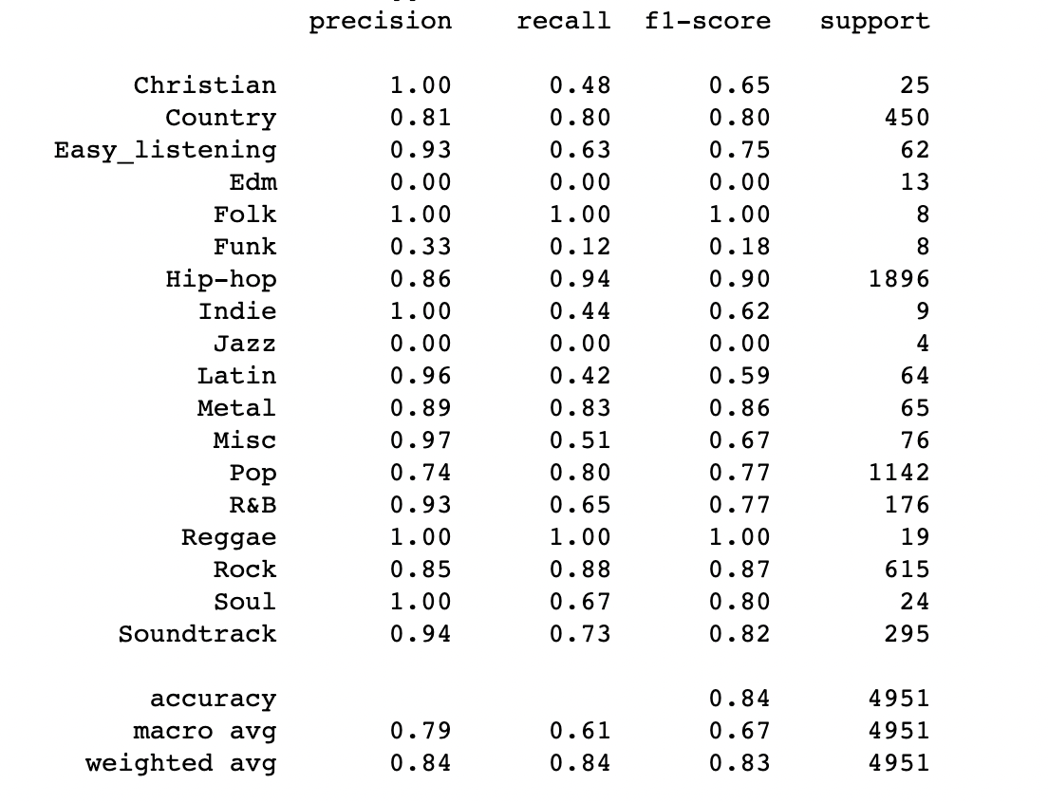

GENRE CLASSIFICATION
K Nearest Neighbors
Random Forest Classifier

Slide 36
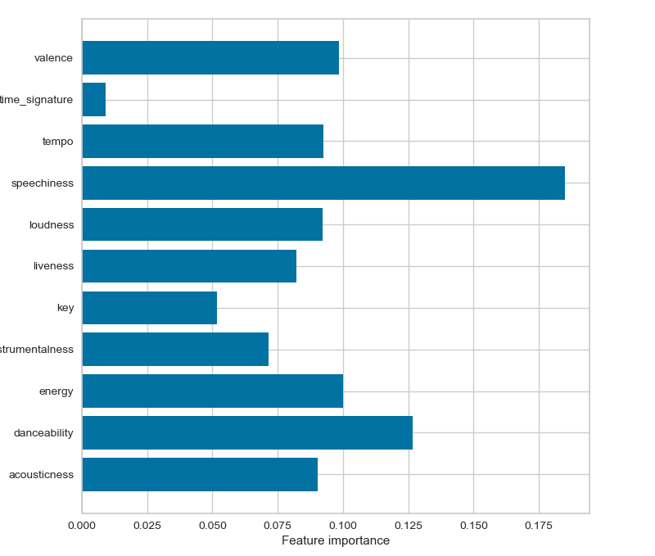
FEATURE INFLUENCE

Slide 37

SUMMARY

Slide 38

SUMMARY
GENRE PRESENCE
ENERGY CHANGE
Hip-hop presence on the charts increased significantly while Country decreased.
Energy also increased during the five-year analysis period.
CORRELATIONS
VALENCE CHANGE
Energy and loudness, energy and valence, and speechiness and danceability were significantly correlated.
Valence generally increased during the five year analysis period, particularly in 2020.

Slide 39

CONCLUSIONS

Slide 40
CONCLUSIONS
DESCRIPTION
DESCRIPTION
Analysis of music features helps entertainment, streaming, and social media companies find focus and gain insight on current musical trends. This allows the maximization of profits and revenue.
Music is a vital part in the human experience and affects each person’s life in some way. The details within the music we love are worth exploring and learning about.

Slide 41
QUESTIONS

Slide 42
OUR CONTACT
SONGS
ADDRESS
Padjadjaran Street No.393
Bandung, West Java
Indonesia 40232
ALBUM
PHONE
+123-456-7890
+987-654-3210
ARTIST
EMAIL
email@slidefactory.com
YOURWEBSITE.COM

Slide 43
THANK YOU
FOR
LISTENING

Slide 44
OUR PORTFOLIO
PORTFOLIO 02
PORTFOLIO 04
Suitable for all categories business and personal presentation
Suitable for all categories business and personal presentation
PORTFOLIO 01
PORTFOLIO 03
Suitable for all categories business and personal presentation
Suitable for all categories business and personal presentation

Slide 45
MUSIC
ARTIST
SONGS
ALBUM
EVENTS
YOURWEBSITE.COM
Title
Subtitle

Slide 46
AGENDA PLAYLIST
ABOUT US
MEET THE TEAM
PORTFOLIO
CHART
TESTIMONIAL
THANK YOU

Slide 47
WELCOME
ALBERT HEINZ
CEO/FOUNDER
“ A wonderful serenity has taken possession of my entire soul, like these sweet mornings of spring which I enjoy with my whole heart. I am alone, and feel the charm of existence in this spot, which was created for the bliss of souls like mine. “

Slide 48
ABOUT US
A collection of textile samples lay spread out on the table - Samsa was a travelling salesman - and above it there hung a picture that he had recently cut out of an illustrated magazine and housed in a nice, gilded frame. It showed a lady fitted out with a fur hat and fur boa who sat upright, raising a heavy fur muff that covered the whole of her lower arm towards the viewer. Gregor then turned to look out the window at the dull weather.
PLAY
FOLLOW

Slide 49
OUR MISSION
A small river named Duden flows by their place and supplies it with the necessary regelialia. It is a paradisematic country, in which roasted parts of sentences fly into your mouth. Even the all-powerful Pointing has no control about the blind texts it is an almost unorthographic life One day however a small line of blind text
DESCRIPTION
DESCRIPTION
DESCRIPTION
DESCRIPTION
Suitable for all categories business and personal presentation
Suitable for all categories business and personal presentation
Suitable for all categories business and personal presentation
Suitable for all categories business and personal presentation

Slide 50

OUR SERVICE
DESCRIPTION
Suitable for all categories business and personal presentation
DESCRIPTION
Far far away, behind the word mountains, far from the countries Vokalia and Consonantia, there live the blind texts. Separated they live in Bookmarksgrove right at the coast of the Semantics,
Suitable for all categories business and personal presentation
DESCRIPTION
Suitable for all categories business and personal presentation
DESCRIPTION
Suitable for all categories business and personal presentation

Slide 51
OUR TIMELINE
2015
2016
DESCRIPTION
DESCRIPTION
Suitable for all categories business and personal presentation
Suitable for all categories business and personal presentation
2017
2018
DESCRIPTION
DESCRIPTION
Suitable for all categories business and personal presentation
Suitable for all categories business and personal presentation

Slide 52
SECTION BREAK

Slide 53
MEET THE TEAM
COURTNEY LOVE
Musician
One morning, when Gregor Samsa woke from troubled dreams, he found himself transformed in his bed into a horrible vermin. He lay on his armour-like back, and if he lifted his head a little he could see his brown belly,
NEW
ALBUM
LINDSAY
SEBASTIAN
JENNIFER
LAURENT
JAMES

Slide 54
THE BEST TEAM
A wonderful serenity has taken possession of my entire soul, like these sweet mornings of spring which I enjoy with my whole heart. I am alone, and feel the charm of existence in this spot, which was created for the bliss of souls
CARMILA LOPEZ
JONATHAN DAVE
Editor
Composer

Slide 55
PROFILE TEAM
MICHAEL DOWNEY
Music Director
One morning, when Gregor Samsa woke from troubled dreams, he found himself transformed in his bed into a horrible vermin. He lay on his armour-like back, and if he lifted his head a little he could see his brown belly,
Skill 01
Skill 02
Skill 03

Slide 56
OUR PORTFOLIO
PORTFOLIO 02
PORTFOLIO 04
Suitable for all categories business and personal presentation
Suitable for all categories business and personal presentation
PORTFOLIO 01
PORTFOLIO 03
Suitable for all categories business and personal presentation
Suitable for all categories business and personal presentation

Slide 57
OUR PORTFOLIO
ARTIST 01
Suitable for all categories business and personal presentation
03:52
ARTIST 02
Suitable for all categories business and personal presentation
05:17
ARTIST 03
Suitable for all categories business and personal presentation
04:39

Slide 58
OUR WORKS
TOP 10 CHART
01
When The Rain Falls
Sugar head
4:43
02
Symphony Day
Eva Mendez
6:25

Slide 59
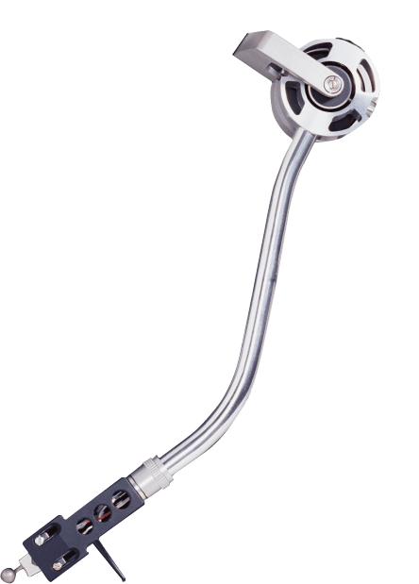

LATEST PROJECT
ARTIST NAME
ALBUM NAME : PROJECT
Indie Folk
2019
SONGLIST
The Big Oxmox advised her not to do so, because there were thousands of bad Commas, wild Question Marks and devious Semikoli, but the Little Blind Text didn’t listen.
01.
Add Song Title
3:56
02.
Add Song Title
4:12
03.
Add Song Title
3:38
04.
Add Song Title
4:27
BUY NOW
05.
Add Song Title
5:00

Slide 60
MUSIC EVENT
EVENT NAME
23 Apr 2019
Far far away, behind the word mountains, far from the countries Vokalia and Consonantia, there live the blind texts. Separated they live in Bookmarksgrove right at the coast of the Semantics,
“ Music is a moral law. It gives soul to the universe, wings to the mind, flight to the imagination, and charm and gaiety to life and to everything. “

Slide 61
SMARTPHONE MOCKUP
A wonderful serenity has taken possession of my entire soul, like these sweet mornings of spring which I enjoy with my whole heart. I am alone, and feel the charm of existence in this spot, which was created for the bliss of souls
DOWNLOAD
OPTION
UPDATE
Suitable for all categories business and personal presentation
Suitable for all categories business and personal presentation
Suitable for all categories business and personal presentation

Slide 62
LAPTOP MOCKUP
DISCOVER YOUR MUSIC
One morning, when Gregor Samsa woke from troubled dreams, he found himself transformed in his bed into a horrible vermin. He lay on his armour-like back, and if he lifted his head a little
Our Product
Competitor Product

Slide 63
TABLET MOCKUP
PLAY YOUR FAVOURITE MUSIC
One morning, when Gregor Samsa woke from troubled dreams, he found himself transformed in his bed into a horrible vermin. He lay on his armour-like back, and if he lifted his head a little he could see his brown belly,
6,350
5,860
2,910
3,100
1,540

Slide 64
NOW PLAYING – VARIOUS ARTIST

Slide 65
OUR FLOWCHART
STEP 02
STEP 04
Suitable for all categories business and personal presentation
Suitable for all categories business and personal presentation
STEP 01
STEP 03
STEP 05
Suitable for all categories business and personal presentation
Suitable for all categories business and personal presentation
Suitable for all categories business and personal presentation

Slide 66
ANNUAL REPORT
DESCRIPTION
A small river named Duden flows by their place and supplies it with the necessary regelialia. It is a paradisematic country, in which roasted parts of sentences fly into your mouth. Even the all-powerful Pointing has no control about the blind texts
READ MORE
JAN
FEB
MAR
APR
MAY
JUN
JUL
AUG
SEP
OCT
NOV
DEC
80,450
$21M
97%
83%
Premium Users
Profit / Year
People Love
People Liked

Slide 67
VOLUME CHART
65%
93%
76%
84%
SOUND
PITCH
BASS
TREBLE
Suitable for all categories business and personal presentation
Suitable for all categories business and personal presentation
Suitable for all categories business and personal presentation
Suitable for all categories business and personal presentation

Slide 68
SALES CHART
713,650,000
62%
A collection of textile samples lay spread out on the table - Samsa was a travelling salesman - and above it there hung a picture that he had recently cut out of an illustrated magazine and housed in a nice, gilded frame.
Suitable for all categories business and personal presentation
$425,000
$437,120
$405,685
$310,000
$318,250

Slide 69
WORLDWIDE MARKET
+78%
+6925
Suitable for all categories business and personal presentation
+7520
+4300
72%
89%
+8210
A wonderful serenity has taken possession of my entire soul, like these sweet mornings of spring which I enjoy with my whole heart.
Far far away, behind the word mountains, far from the countries Vokalia and Consonantia, there live the blind texts. Separated they live in Bookmarksgrove right at the coast

Slide 70
AUSTRALIA MAP
DESCRIPTION
A small river named Duden flows by their place and supplies it with the necessary regelialia. It is a paradisematic country, in which roasted parts of sentences fly into your mouth. Even the all-powerful Pointing has no control about the blind texts
Region 01
70%
Region 02
90%
Region 03
80%

Slide 71
PRICE TABLE
FREE TRIAL
BASIC
PREMIUM
MENU
MENU
MENU
$0
$15
$25

Slide 72
OFFICIAL PARTNERS
SHANIA MENDEZ
Musician
“ I should be incapable of drawing a single stroke at the present moment; and yet I feel that I never was a greater artist than now. When, while the lovely valley teems with vapour around me “

Slide 73
OUR CONTACT
SONGS
ADDRESS
Padjadjaran Street No.393
Bandung, West Java
Indonesia 40232
ALBUM
PHONE
+123-456-7890
+987-654-3210
ARTIST
EMAIL
email@slidefactory.com
YOURWEBSITE.COM

Slide 74
THANK YOU
FOR
LISTENING

